Slide 1
COMPUTER GRAPHICS AND VISUALIZATION 18CS62
Faculty Name : Sougandhika Narayan
Asst. Professor, Department of CSE
KSIT, Bangalore
COMPUTER GRAPHICS AND VISUALIZATION, Sougandhika Narayan, Asst Prof, Dept of CSE, KSIT

Slide 2
Module - 2
Fill area Primitives, 2D Geometric Transformations and 2D viewing

Slide 3
Topics Covered :
Introduction Polygon fill-areas
OpenGL polygon Fill Area Functions
Fill area attributes
General scan line polygon fill algorithm
OpenGL fill-area Attribute functions.

Slide 4

Introduction
An useful construct for describing components of a picture is an area that is filled with some solid color or pattern.
A picture component of this type is typically referred to as a fill area or a filled area.
Any fill-area shape is possible, graphics libraries generally do not support specifications for arbitrary fill shapes
Figure illustrates a few possible fill-area shapes.

Slide 5
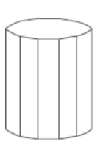
Graphics routines can more efficiently process polygons than other kinds of fill shapes because polygon boundaries are described with linear equations.
When lighting effects and surface-shading procedures are applied, an approximated curved surface can be displayed quite realistically.
Approximating a curved surface with polygon facets is sometimes referred to as surface tessellation, or fitting the surface with a polygon mesh.
Displays of such figures can be generated quickly as wire-frame views, showing only the polygon edges to give a general indication of the surface structure
Objects described with a set of polygon surface patches are usually referred to as standard graphics objects, or just graphics objects.

Slide 6
Polygon Fill Areas
A polygon is a plane figure specified by a set of three or more coordinate positions, called vertices, that are connected in sequence by straight-line segments, called the edges or sides of the polygon.
It is required that the polygon edges have no common point other than their endpoints.
Thus, by definition, a polygon must have all its vertices within a single plane and there can be no edge crossings
Examples of polygons include triangles, rectangles, octagons, and decagons
Any plane figure with a closed-polyline boundary is alluded to as a polygon, and one with no crossing edges is referred to as a standard polygon or a simple polygon

Slide 7
Problem:
For a computer-graphics application, it is possible that a designated set of polygon vertices do not all lie exactly in one plane
This is due to roundoff error in the calculation of numerical values, to errors in selecting coordinate positions for the vertices, or, more typically, to approximating a curved surface with a set of polygonal patches
Solution:
To divide the specified surface mesh into triangles

Slide 8
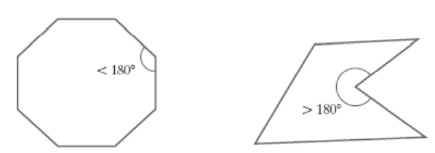
Polygon Classifications
Polygons are classified into two types
Convex Polygon
Concave Polygon
Convex Polygon:
The polygon is convex if all interior angles of a polygon are less than or equal to 180◦, where an interior angle of a polygon is an angle inside the polygon boundary that is formed by two adjacent edges
An equivalent definition of a convex polygon is that its interior lies completely on one side of the infinite extension line of any one of its edges.
Also, if we select any two points in the interior of a convex polygon, the line segment joining the two points is also in the interior.

Slide 9
Concave Polygon: A concave polygon has at least one interior angle greater than 180◦.
Problems in concave polygon:
Implementations of fill algorithms and other graphics routines are more complicated
Solution:
It is generally more efficient to split a concave polygon into a set of convex polygons before processing
Identifying Concave Polygons
Characteristics:
A concave polygon has at least one interior angle greater than 180◦.
The extension of some edges of a concave polygon will intersect other edges,
Some pair of interior points will produce a line segment that intersects the polygon boundary

Slide 10
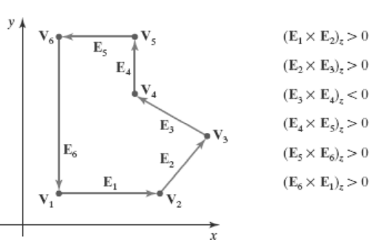
Identification algorithm 1
Identifying a concave polygon by calculating cross-products of successive pairs of edge vectors.
If we set up a vector for each polygon edge, then we can use the cross-product of adjacent edges to test for concavity. All such vector products will be of the same sign (positive or negative) for a convex polygon.
Therefore, if some cross-products yield a positive value and some a negative value, we have a concave polygon

Slide 11
Identification algorithm 2
Look at the polygon vertex positions relative to the extension line of any edge.
If some vertices are on one side of the extension line and some vertices are on the other side, the polygon is concave.
Splitting Concave Polygons
Split concave polygon into a set of convex polygons using edge vectors and edge cross products; or, we can use vertex positions relative to an edge extension line to determine which vertices are on one side of this line and which are on the other.

Slide 12
Vector method
First need to form the edge vectors.
Given two consecutive vertex positions, V_{k} and V_{k+1} , we define the edge vector between them as E_{k} = V_{k+1} – V_{k}
Calculate the cross-products of successive edge vectors in order around the polygon perimeter.
If the z component of some cross-products is positive while other cross-products have a negative z component, the polygon is concave.
We can apply the vector method by processing edge vectors in counterclockwise order If any cross-product has a negative z component (as in figure), the polygon is concave and we can split it along the line of the first edge vector in the cross-product pair

Slide 13
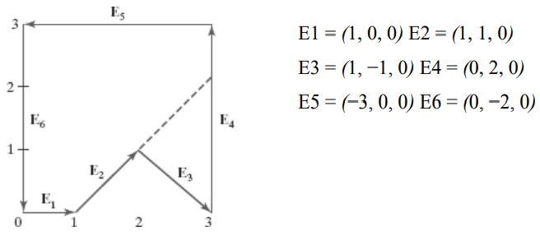
Where the z component is 0, since all edges are in the xy plane.
The cross-product E_{j} × E_{k}
for two successive edge vectors is a vector perpendicular to the xy plane with z component equal to E_{jx}E_{ky} − E_{kx}E_{jy}:
The values for the figure is as follows
E1 × E2 = (0, 0, 1)
E2 × E3 = (0, 0, −2)
E3 × E4 = (0, 0, 2)
E4 × E5 = (0, 0, 6)
E5 × E6 = (0, 0, 6)
E6 × E1 = (0, 0, 2)

Slide 14
Since the cross-product E2 × E3 has a negative z component, we split the polygon along the line of vector E2.
The line equation for this edge has a slope of 1 and a y intercept of −1 . No other edge cross-products are negative, so the two new polygons are both convex.

Slide 15
Rotational method
Proceeding counterclockwise around the polygon edges, we shift the position of the polygon so that each vertex Vk in turn is at the coordinate origin.
We rotate the polygon about the origin in a clockwise direction so that the next vertex Vk+1 is on the x axis.
If the following vertex, Vk+2, is below the x axis, the polygon is concave.
We then split the polygon along the x axis to form two new polygons, and we repeat the concave test for each of the two new polygons

Slide 16
Splitting a Convex Polygon into a Set of Triangles
Once we have a vertex list for a convex polygon, we could transform it into a set of triangles.
First define any sequence of three consecutive vertices to be a new polygon (a triangle).
The middle triangle vertex is then deleted from the original vertex list.
The same procedure is applied to this modified vertex list to strip off another triangle.
We continue forming triangles in this manner until the original polygon is reduced to just three vertices, which define the last triangle in the set.
Concave polygon can also be divided into a set of triangles using this approach, although care must be taken that the new diagonal edge formed by joining the first and third selected vertices does not cross the concave portion of the polygon, and that the three selected vertices at each step form an interior angle that is less than 180◦

Slide 17
Identifying interior and exterior region of polygon
We may want to specify a complex fill region with intersecting edges.
For such shapes, it is not always clear which regions of the xy plane we should call “interior” and which regions.
We should designate as “exterior” to the object boundaries.
Two commonly used algorithms
Odd-Even rule
The nonzero winding-number rule.

Slide 18
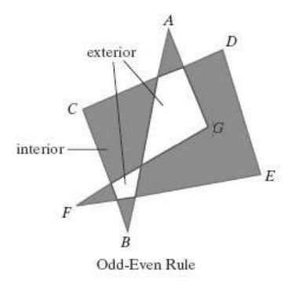
Inside-Outside Tests
Also called the odd-parity rule or the even-odd rule.
Draw a line from any position P to a distant point outside the coordinate extents of the closed polyline.
Then we count the number of line-segment crossings along this line.
If the number of segments crossed by this line is odd, then P is considered to be an interior point Otherwise, P is an exterior point
We can use this procedure, for example, to fill the interior region between two concentric circles or two concentric polygons with a specified color.

Slide 19
Nonzero Winding-Number rule
This counts the number of times that the boundary of an object “winds” around a particular point in the counterclockwise direction termed as winding number,
Initialize the winding number to 0 and again imagining a line drawn from any position P to a distant point beyond the coordinate extents of the object.
The line we choose must not pass through any endpoint coordinates.
As we move along the line from position P to the distant point, we count the number of object line segments that cross the reference line in each direction
We add 1 to the winding number every time we intersect a segment that crosses the line in the direction from right to left, and we subtract 1 very time we intersect a segment that crosses from left to right

Slide 20
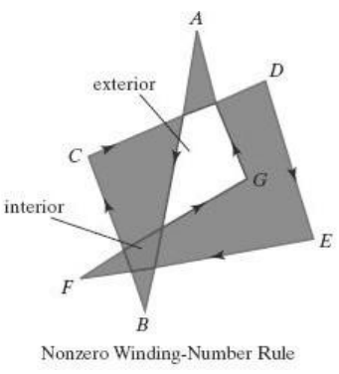
If the winding number is nonzero, P is considered to be an interior point. Otherwise, P is taken to be an exterior point
The nonzero winding-number rule tends to classify as interior some areas that the odd-even rule deems to be exterior.
Variations of the nonzero winding-number rule can be used to define interior regions in other ways define a point to be interior if its winding number is positive or if it is negative; or we could use any other rule to generate a variety of fill shapes
Boolean operations are used to specify a fill area as a combination of two regions

Slide 21
Polygon Tables
The objects in a scene are described as sets of polygon surface facets
The description for each object includes coordinate information specifying the geometry for the polygon facets and other surface parameters such as color, transparency, and light reflection properties.
The data of the polygons are placed into tables that are to be used in the subsequent processing, display, and manipulation of the objects in the scene. These polygon data tables can be organized into two groups:
Geometric tables
Attribute tables

Slide 22
Geometric data tables
contain vertex coordinates and parameters to identify the spatial orientation of the polygon surfaces.
Attribute information for an object includes parameters specifying the degree of transparency of the object and its surface reflectivity and texture characteristics
Geometric data for the objects in a scene are arranged conveniently in three lists: a vertex table, an edge table, and a surface-facet table.
Coordinate values for each vertex in the object are stored in the vertex table.
The edge table contains pointers back into the vertex table to identify the vertices for each polygon edge.
And the surface-facet table contains pointers back into the edge table to identify the edges for each polygon

Slide 23
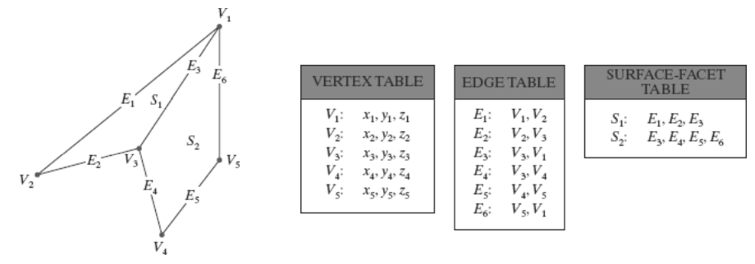
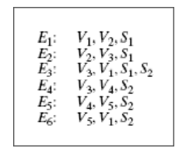

Slide 24
Because the geometric data tables may contain extensive listings of vertices and edges for complex objects and scenes, it is important that the data be checked for consistency and completeness.
Some of the tests that could be performed by a graphics package are:
(1) that every vertex is listed as an endpoint for at least two edges
(2) that every edge is part of at least one polygon
(3) that every polygon is closed
(4) that each polygon has at least one shared edge
(5) that if the edge table contains pointers to polygons, every edge referenced by a polygon pointer has a reciprocal pointer back to the polygon.

Slide 25
Plane Equations
Each polygon in a scene is contained within a plane of infinite extent.
The general equation of a plane is Ax + B y + C z + D = 0 Where,
(x, y, z) is any point on the plane, and
The coefficients A, B, C, and D (called plane parameters) are constants describing the spatial properties of the plane.
We can obtain the values of A, B, C, and D by solving a set of three plane equations using the coordinate values for three noncollinear points in the plane for the three successive convex-polygon vertices, (x1, y1, z1), (x2, y2, z2), and (x3, y3, z3), in a counterclockwise order and solve the following set of simultaneous linear plane equations for the ratios A/D, B/D, and C/D: (A/D)xk + (B/D)yk + (C/D)zk = −1, k = 1, 2, 3

Slide 26
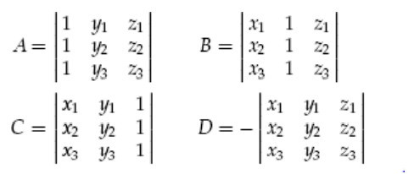
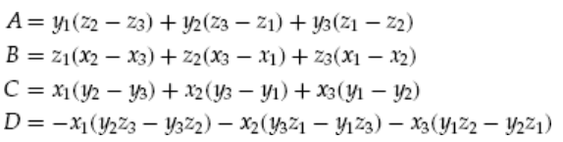
The solution to this set of equations can be obtained in determinant form, using Cramer’s rule, as
Expanding the determinants, we can write the calculations for the plane coefficients in the form

Slide 27
It is possible that the coordinates defining a polygon facet may not be contained within a single plane.
We can solve this problem by dividing the facet into a set of triangles; or we could find an approximating plane for the vertex list.
One method for obtaining an approximating plane is to divide the vertex list into subsets, where each subset contains three vertices, and calculate plane parameters A, B, C, Dfor each subset

Slide 28
Front and Back Polygon Faces
The side of a polygon that faces into the object interior is called the back face, and the visible, or outward, side is the front face .
Every polygon is contained within an infinite plane that partitions space into two regions.
Any point that is not on the plane and that is visible to the front face of a polygon surface section is said to be in front of (or outside) the plane, and, thus, outside the object.
Any point that is visible to the back face of the polygon is behind (or inside) the plane.
Plane equations can be used to identify the position of spatial points relative to the polygon facets of an object.
For any point (x, y, z) not on a plane with parameters A, B, C, D, we have Ax + B y + C z + D != 0
Thus, we can identify the point as either behind or in front of a polygon surface contained within that plane according to the sign (negative or positive) of
Ax + By + Cz + D:
if Ax + B y + C z + D < 0, the point (x, y, z) is behind the plane
if Ax + B y + C z + D > 0, the point (x, y, z) is in front of the plane

Slide 29
Orientation of a polygon surface in space can be described with the normal vector for the plane containing that polygon
The normal vector points in a direction from inside the plane to the outside; that is, from the back face of the polygon to the front face.
Thus, the normal vector for this plane is N = (1, 0, 0), which is in the direction of the positive x axis.
That is, the normal vector is pointing from inside the cube to the outside and is perpendicular to the plane x = 1.
The elements of a normal vector can also be obtained using a vector cross product Calculation.
We have a convex-polygon surface facet and a right-handed Cartesian system, we again select any three vertex positions,V1,V2, and V3, taken in counterclockwise order when viewing from outside the object toward the inside.
Forming two vectors, one from V1 to V2 and the second from V1 to V3, we calculate N as the vector cross-product: N = (V2 − V1) × (V3 − V1)

Slide 30
OpenGL Polygon Fill-Area Functions
A glVertex function is used to input the coordinates for a single polygon vertex, and a complete polygon is described with a list of vertices placed between a glBegin/glEnd pair.
By default, a polygon interior is displayed in a solid color, determined by the current color settings we can fill a polygon with a pattern and we can display polygon edges as line borders around the interior fill.
There are six different symbolic constants that we can use as the argument in the glBegin function to describe polygon fill areas
In some implementations of OpenGL, the following routine can be more efficient than generating a fill rectangle using glVertex specifications: glRect* (x1, y1, x2, y2);
One corner of this rectangle is at coordinate position (x1, y1), and the opposite corner of the rectangle is at position (x2, y2)

Slide 31
Example
glRecti (200, 100, 50, 250);
If we put the coordinate values for this rectangle into arrays, we can generate the same square with the following code:
int vertex1 [ ] = {200, 100};
int vertex2 [ ] = {50, 250};
glRectiv (vertex1, vertex2);

Slide 32
Polygon
With the OpenGL primitive constant GL POLYGON, we can display a single polygon fill area.
Each of the points is represented as an array of (x, y) coordinate values:
glBegin (GL_POLYGON);
glVertex2iv (p1);
glVertex2iv (p2);
glVertex2iv (p3);
glVertex2iv (p4);
glVertex2iv (p5);
glVertex2iv (p6);
glEnd ( );

Slide 33
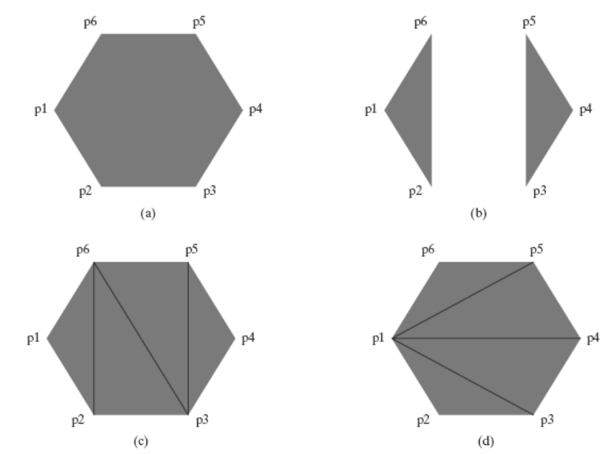
A single convex polygon fill area generated with the primitive constant GL POLYGON.
Two unconnected triangles generated with GL TRIANGLES.
Four connected triangles generated with GL TRIANGLE STRIP.
Four connected triangles generated with GL TRIANGLE FAN.

Slide 34
Triangles
Displays the triangles.
Three primitives in triangles, GL_TRIANGLES, GL_TRIANGLE_FAN, GL_TRIANGLE_STRIP
glBegin(GL_TRIANGLES);
glVertex2iv(p1);
glVertex2iv(p2);
glVertex2iv(p6);
glVertex2iv(p3);
glVertex2iv(p4);
glVertex2iv(p5);
glEnd();

Slide 35
Triangle Fan
Another way to generate a set of connected triangles is to use the “fan” Approach
glBegin (GL_TRIANGLE_FAN);
glVertex2iv (p1);
glVertex2iv (p2);
glVertex2iv (p3);
glVertex2iv (p4);
glVertex2iv (p5);
glVertex2iv (p6);
glEnd ( );
For N vertices, we again obtain N−2 triangles, providing no vertex positions are repeated, and we must list at least three vertices be specified in the proper order to define front and back faces for each triangle correctly.
Therefore, triangle 1 is defined with the vertex list (p1, p2, p3); triangle 2 has the vertex ordering (p1, p3, p4); triangle 3 has its vertices specified in the order (p1, p4, p5); and triangle 4 is listed with vertices (p1, p5, p6).

Slide 36
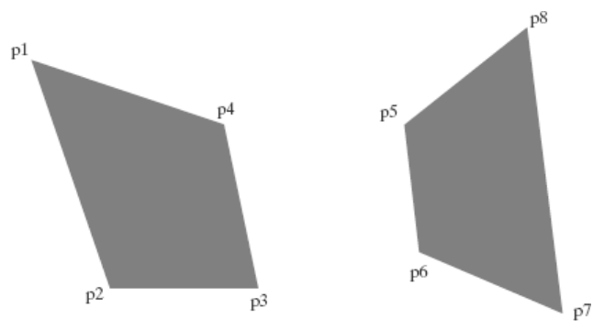
Quadrilaterals
OpenGL provides for the specifications of two types of quadrilaterals.
With the GL_QUADS primitive constant and the following list of eight vertices, specified as two-dimensional coordinate arrays, we can generate the display shown in Figure :
glBegin (GL_QUADS);
glVertex2iv(p1);
glVertex2iv(p2);
glVertex2iv(p3);
glVertex2iv(p4);
glVertex2iv(p5);
glVertex2iv(p6);
glVertex2iv(p7);
glVertex2iv(p8);
glEnd( );

Slide 37
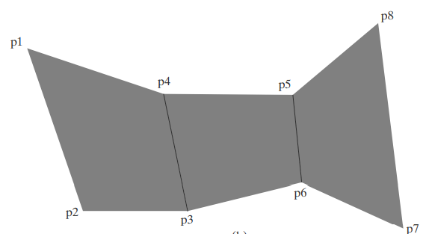
Rearranging the vertex list in the previous quadrilateral code example and changing the primitive constant to GL_QUAD_STRIP, we can obtain the set of connected quadrilaterals shown in Figure :
glBegin (GL_QUAD_STRIP);
glVertex2iv(p1);
glVertex2iv(p2);
glVertex2iv(p4);
glVertex2iv(p3);
glVertex2iv(p5);
glVertex2iv(p6);
glVertex2iv(p8);
glVertex2iv(p7);
glEnd( );

Slide 38
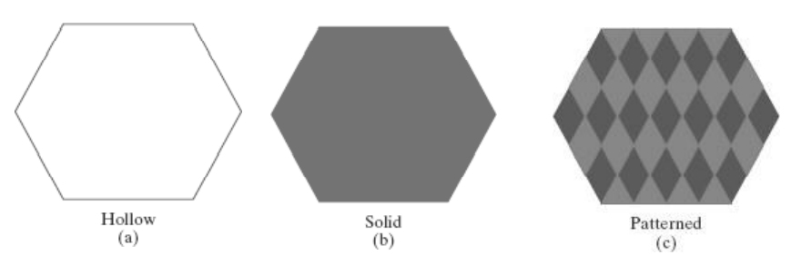
Fill-Area Attributes
We can fill any specified regions, including circles, ellipses, and other objects with curved boundaries Fill Styles
A basic fill-area attribute provided by a general graphics library is the display style of the interior.
We can display a region with a single color, a specified fill pattern, or in a “hollow” style by showing only the boundary of the region

Slide 39
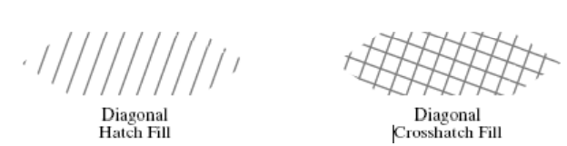
Fill patterns can be defined in rectangular color arrays that list different colors for different positions in the array.
This process of filling an area with a rectangular pattern is called tiling, and a rectangular fill pattern is sometimes referred to as a tiling pattern predefined fill patterns are available in a system, such as the hatch fill patterns

Slide 40
General Scan-Line Polygon-Fill Algorithm
A scan-line fill of a region is performed by first determining the intersection positions of the boundaries of the fill region with the screen scan lines.
Then the fill colors are applied to each section of a scan line that lies within the interior of the fill region.
The simplest area to fill is a polygon because each scanline intersection point with a polygon boundary is obtained by solving a pair of simultaneous linear equations, where the equation for the scan line is simply y = constant.

Slide 41
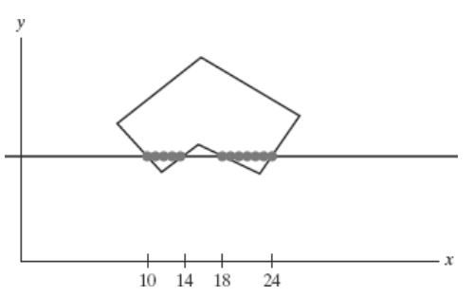
Figure above illustrates the basic scan-line procedure for a solid-color fill of a polygon.
For each scan line that crosses the polygon, the edge intersections are sorted from left to right, and then the pixel positions between, and including, each intersection pair are set to the specified fill color the fill color is applied to the five pixels from x = 10 to x = 14 and to the seven pixels from x = 18 to x = 24.
Whenever a scan line passes through a vertex, it intersects two polygon edges at that point.
In some cases, this can result in an odd number of boundary intersections for a scan line

Slide 42
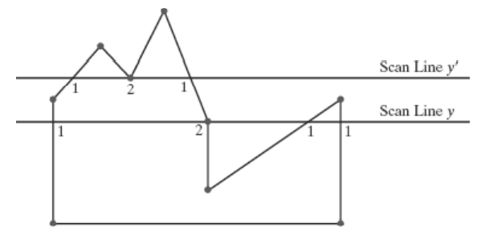
Scan line y’ intersects an even number of edges, and the two pairs of intersection points along this scan line correctly identify the interior pixel spans.
But scan line y intersects five polygon edges.
Thus, as we process scan lines, we need to distinguish between these cases.
For scan line y, the two edges sharing an intersection vertex are on opposite sides of the scan line.
But for scan line y’, the two intersecting edges are both above the scan line.

